Slide 1
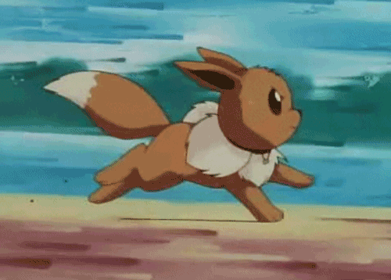
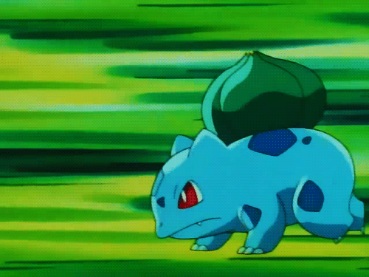
Story Time

Slide 2
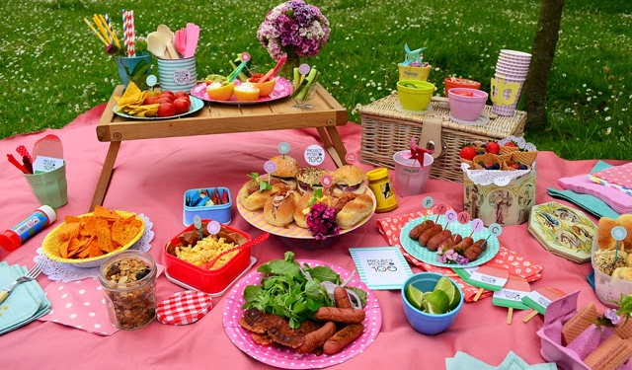
Danny’s mom: Come here, kids.
Danny: What do you want, Irene?
Irene: I want a hot dog. Thank you.

Slide 3
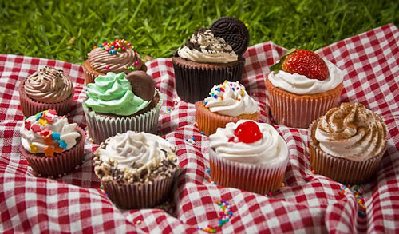
Danny: What do you want, Miss Lee?
Miss Lee: I want two cupcakes, please.
Danny: Here you are.
Miss Lee: Thank you, Danny.

Slide 4
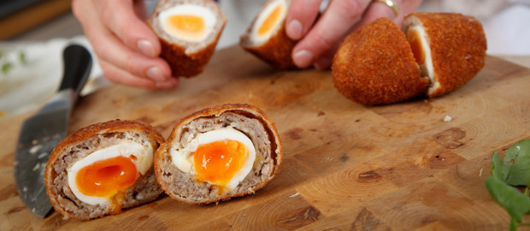
Danny: What do you want, Owen?
Owen: Hmm…Let me see.
What are these?
Danny: They’re eggs.

Slide 5
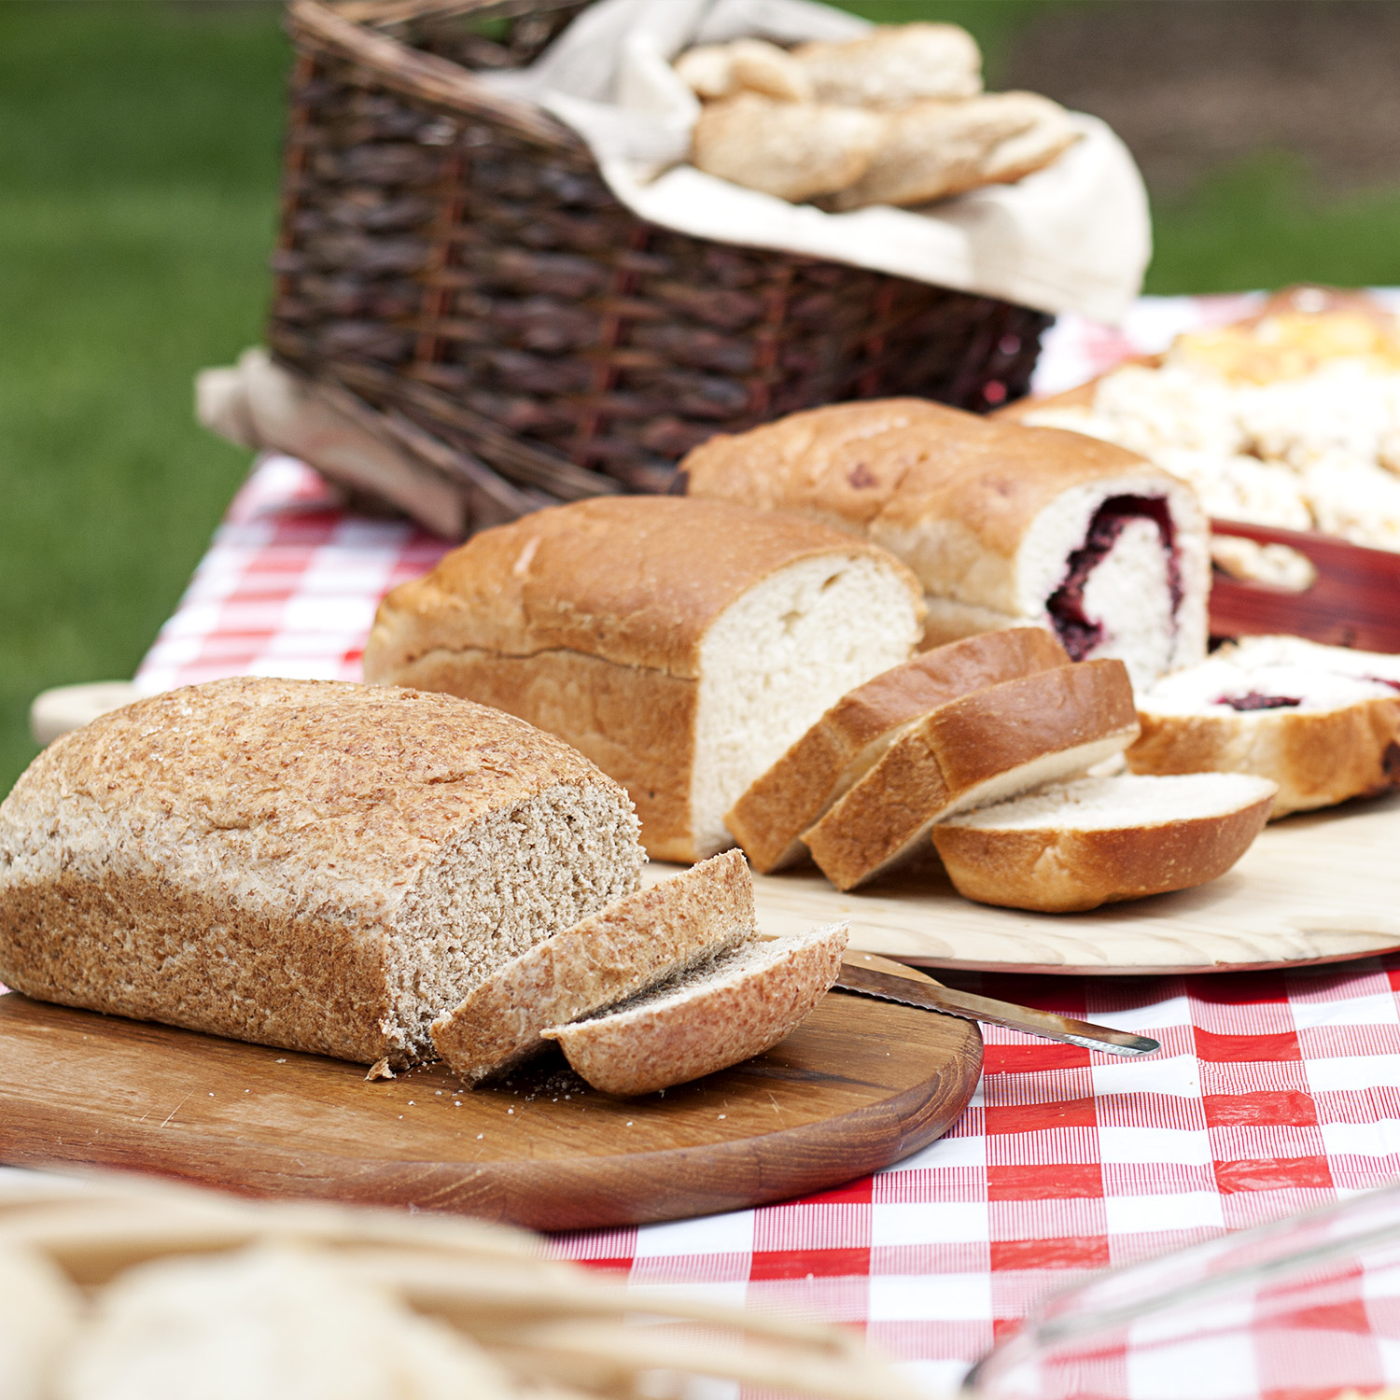
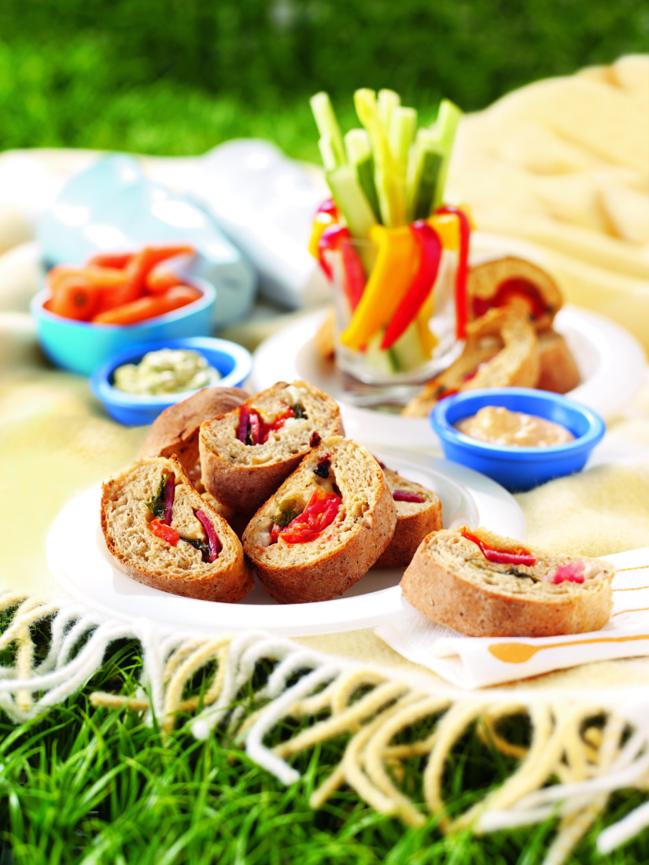
Danny: Hurry up!
Owen: I want some bread, please.
Thanks, Dino.
Dino: Hey! That’s my bread!

Slide 6
Daily talk!!

Slide 7
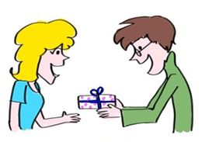
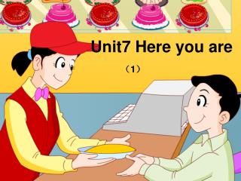
Here you are!

Slide 8
Hurry up!

Slide 9
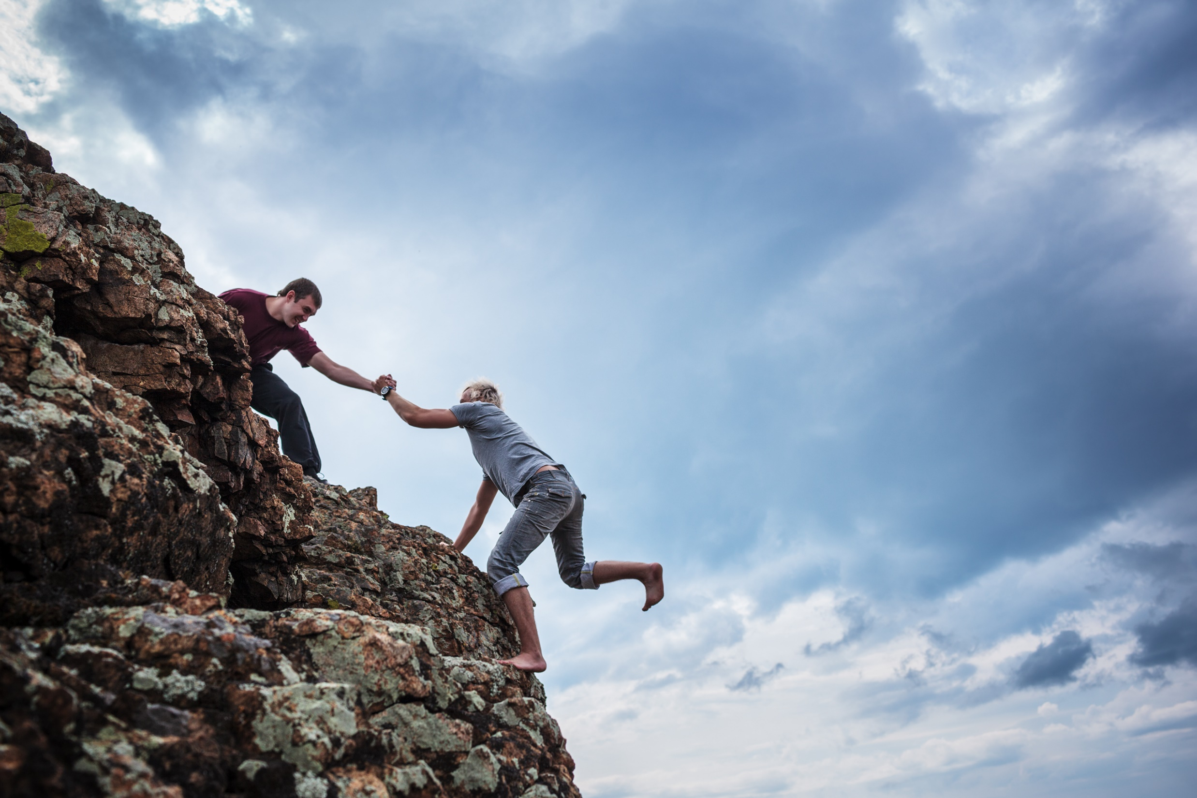
Help! Help!
SOS

Slide 10
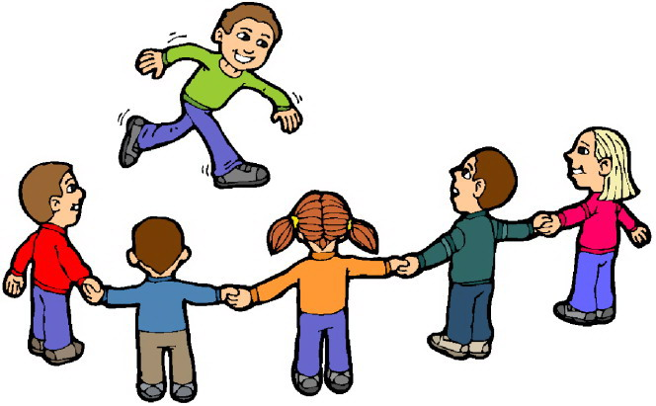
May I join you?
Of course!

Slide 11
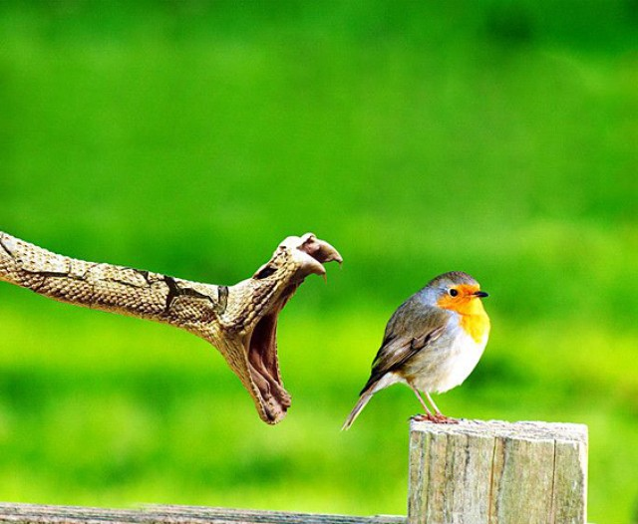
Watch out!

Slide 12
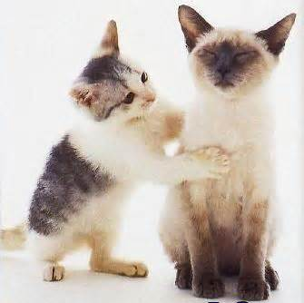
Are you OK?

Slide 13
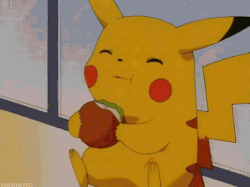
Yummy!

Slide 14
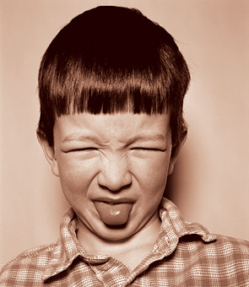
Yuck!

Slide 15
P64~P65

Slide 16
-ug
-un

Slide 17
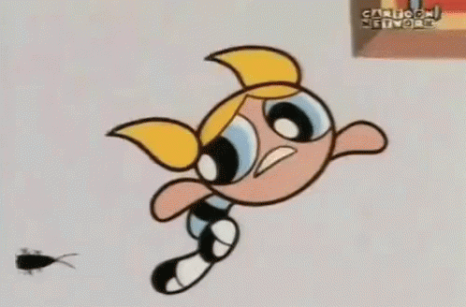
ug
b

Slide 18
m
ug

Slide 19
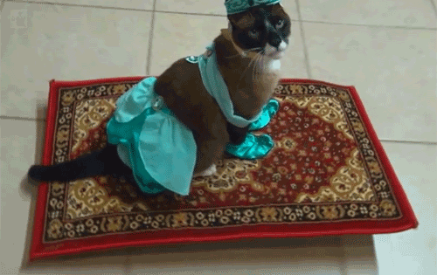
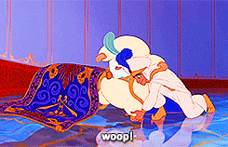
r
ug

Slide 20
This is a bug.

Slide 21
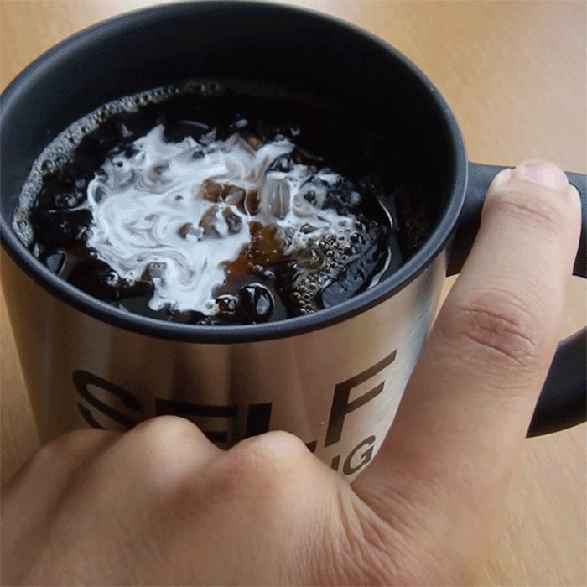
The bug is in the mug.

Slide 22
The mug is on the rug.

Slide 23
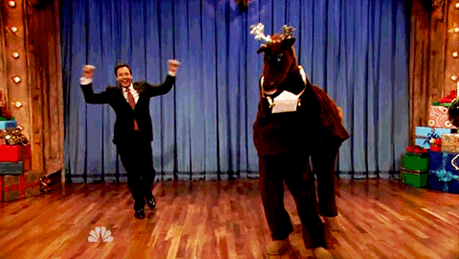
un
f

Slide 24
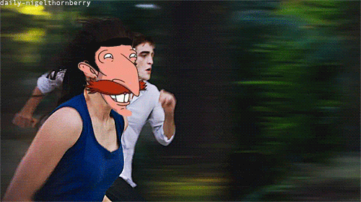
r
un

Slide 25
s
un

Slide 26
I like the sun.

Slide 27
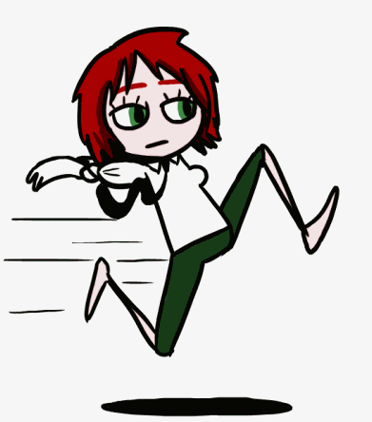
I like to run.

Slide 28
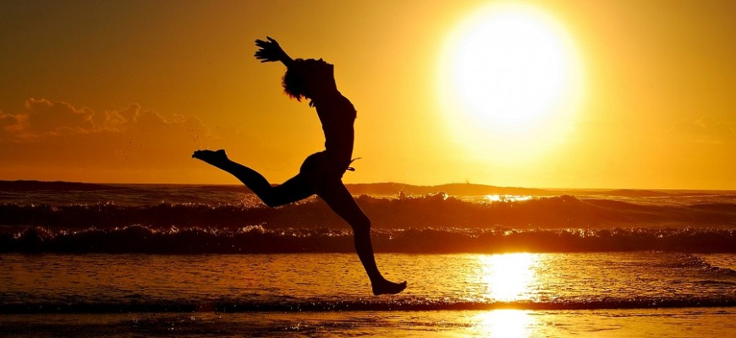
It’s fun to run in the sun.

Slide 29
This is a bug.
The bug is in the mug.
The mug is on the rug.

Slide 30
This is a bug.
The bug’s in the mug.
The mug’s on the rug.

Slide 31
I like the sun.
I like to run.
It’s fun to run in the sun.

Slide 32
-og
-ock

Slide 33
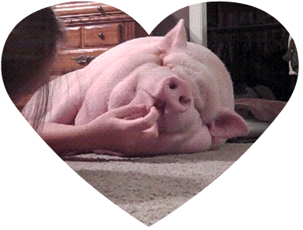
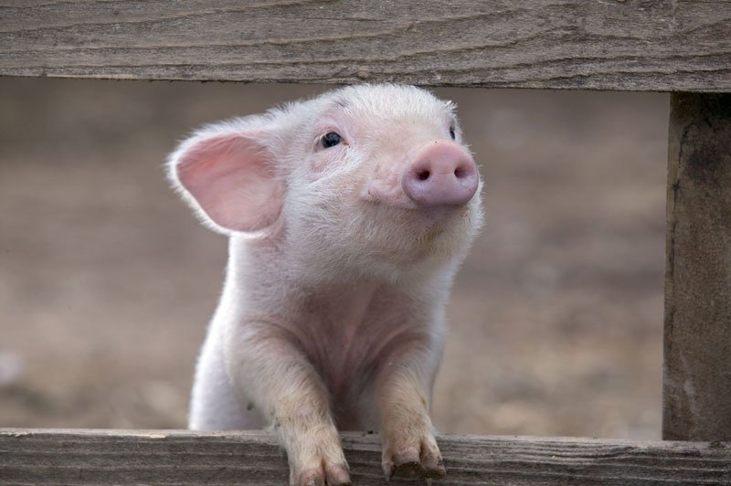
og
h

Slide 34
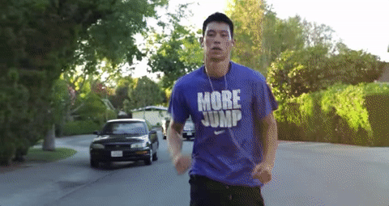
j
og

Slide 35
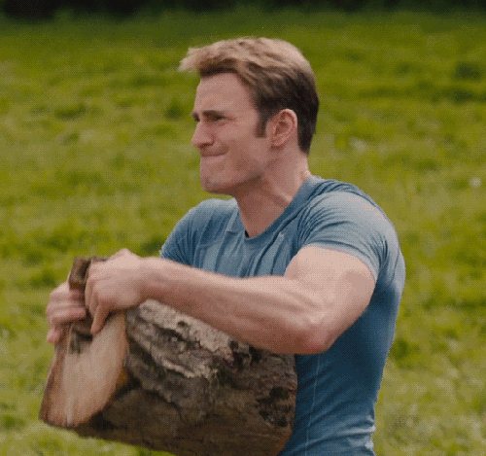
l
og

Slide 36
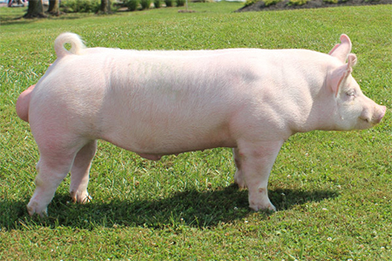
This is a hog.

Slide 37
The hog likes to jog.

Slide 38
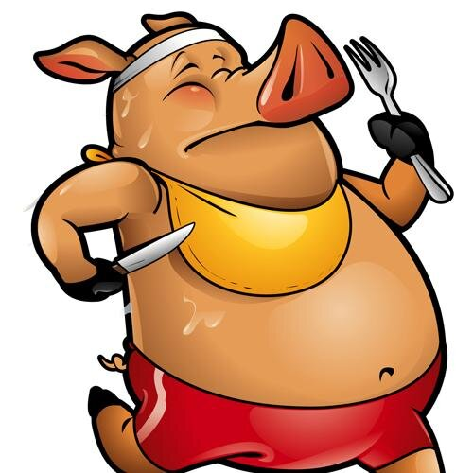
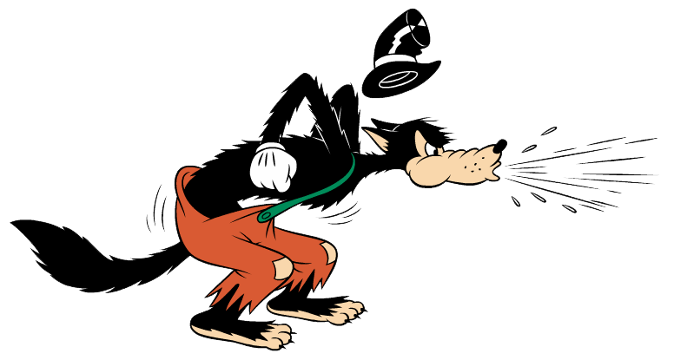
The hog likes to jog with a hog.

Slide 39
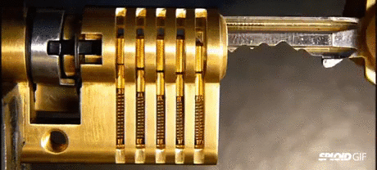
ock
l

Slide 40
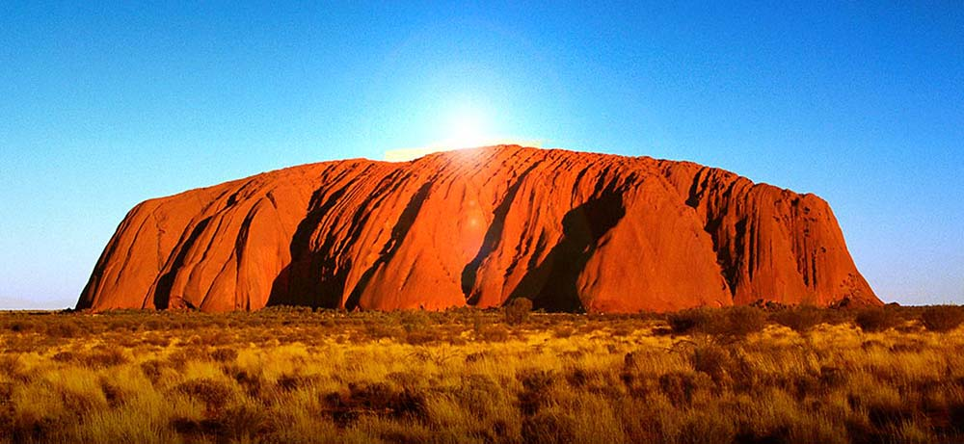
ock
r
Ayers Rock in Australia

Slide 41
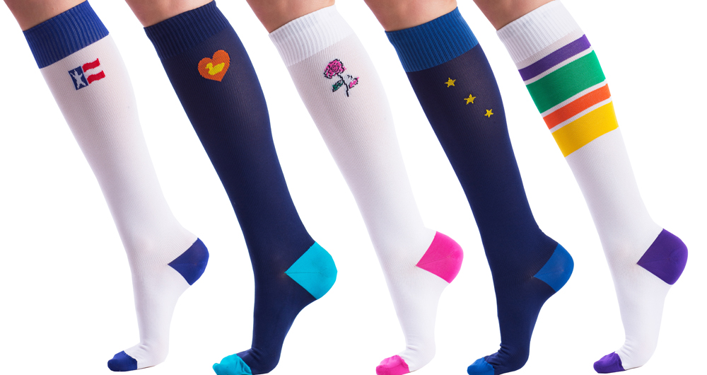
ock
s

Slide 42
This is a lock.
These are locks.

Slide 43
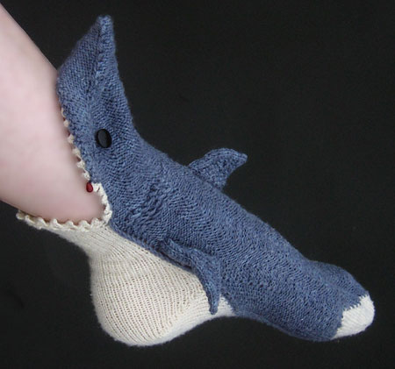
This is a sock.

Slide 44
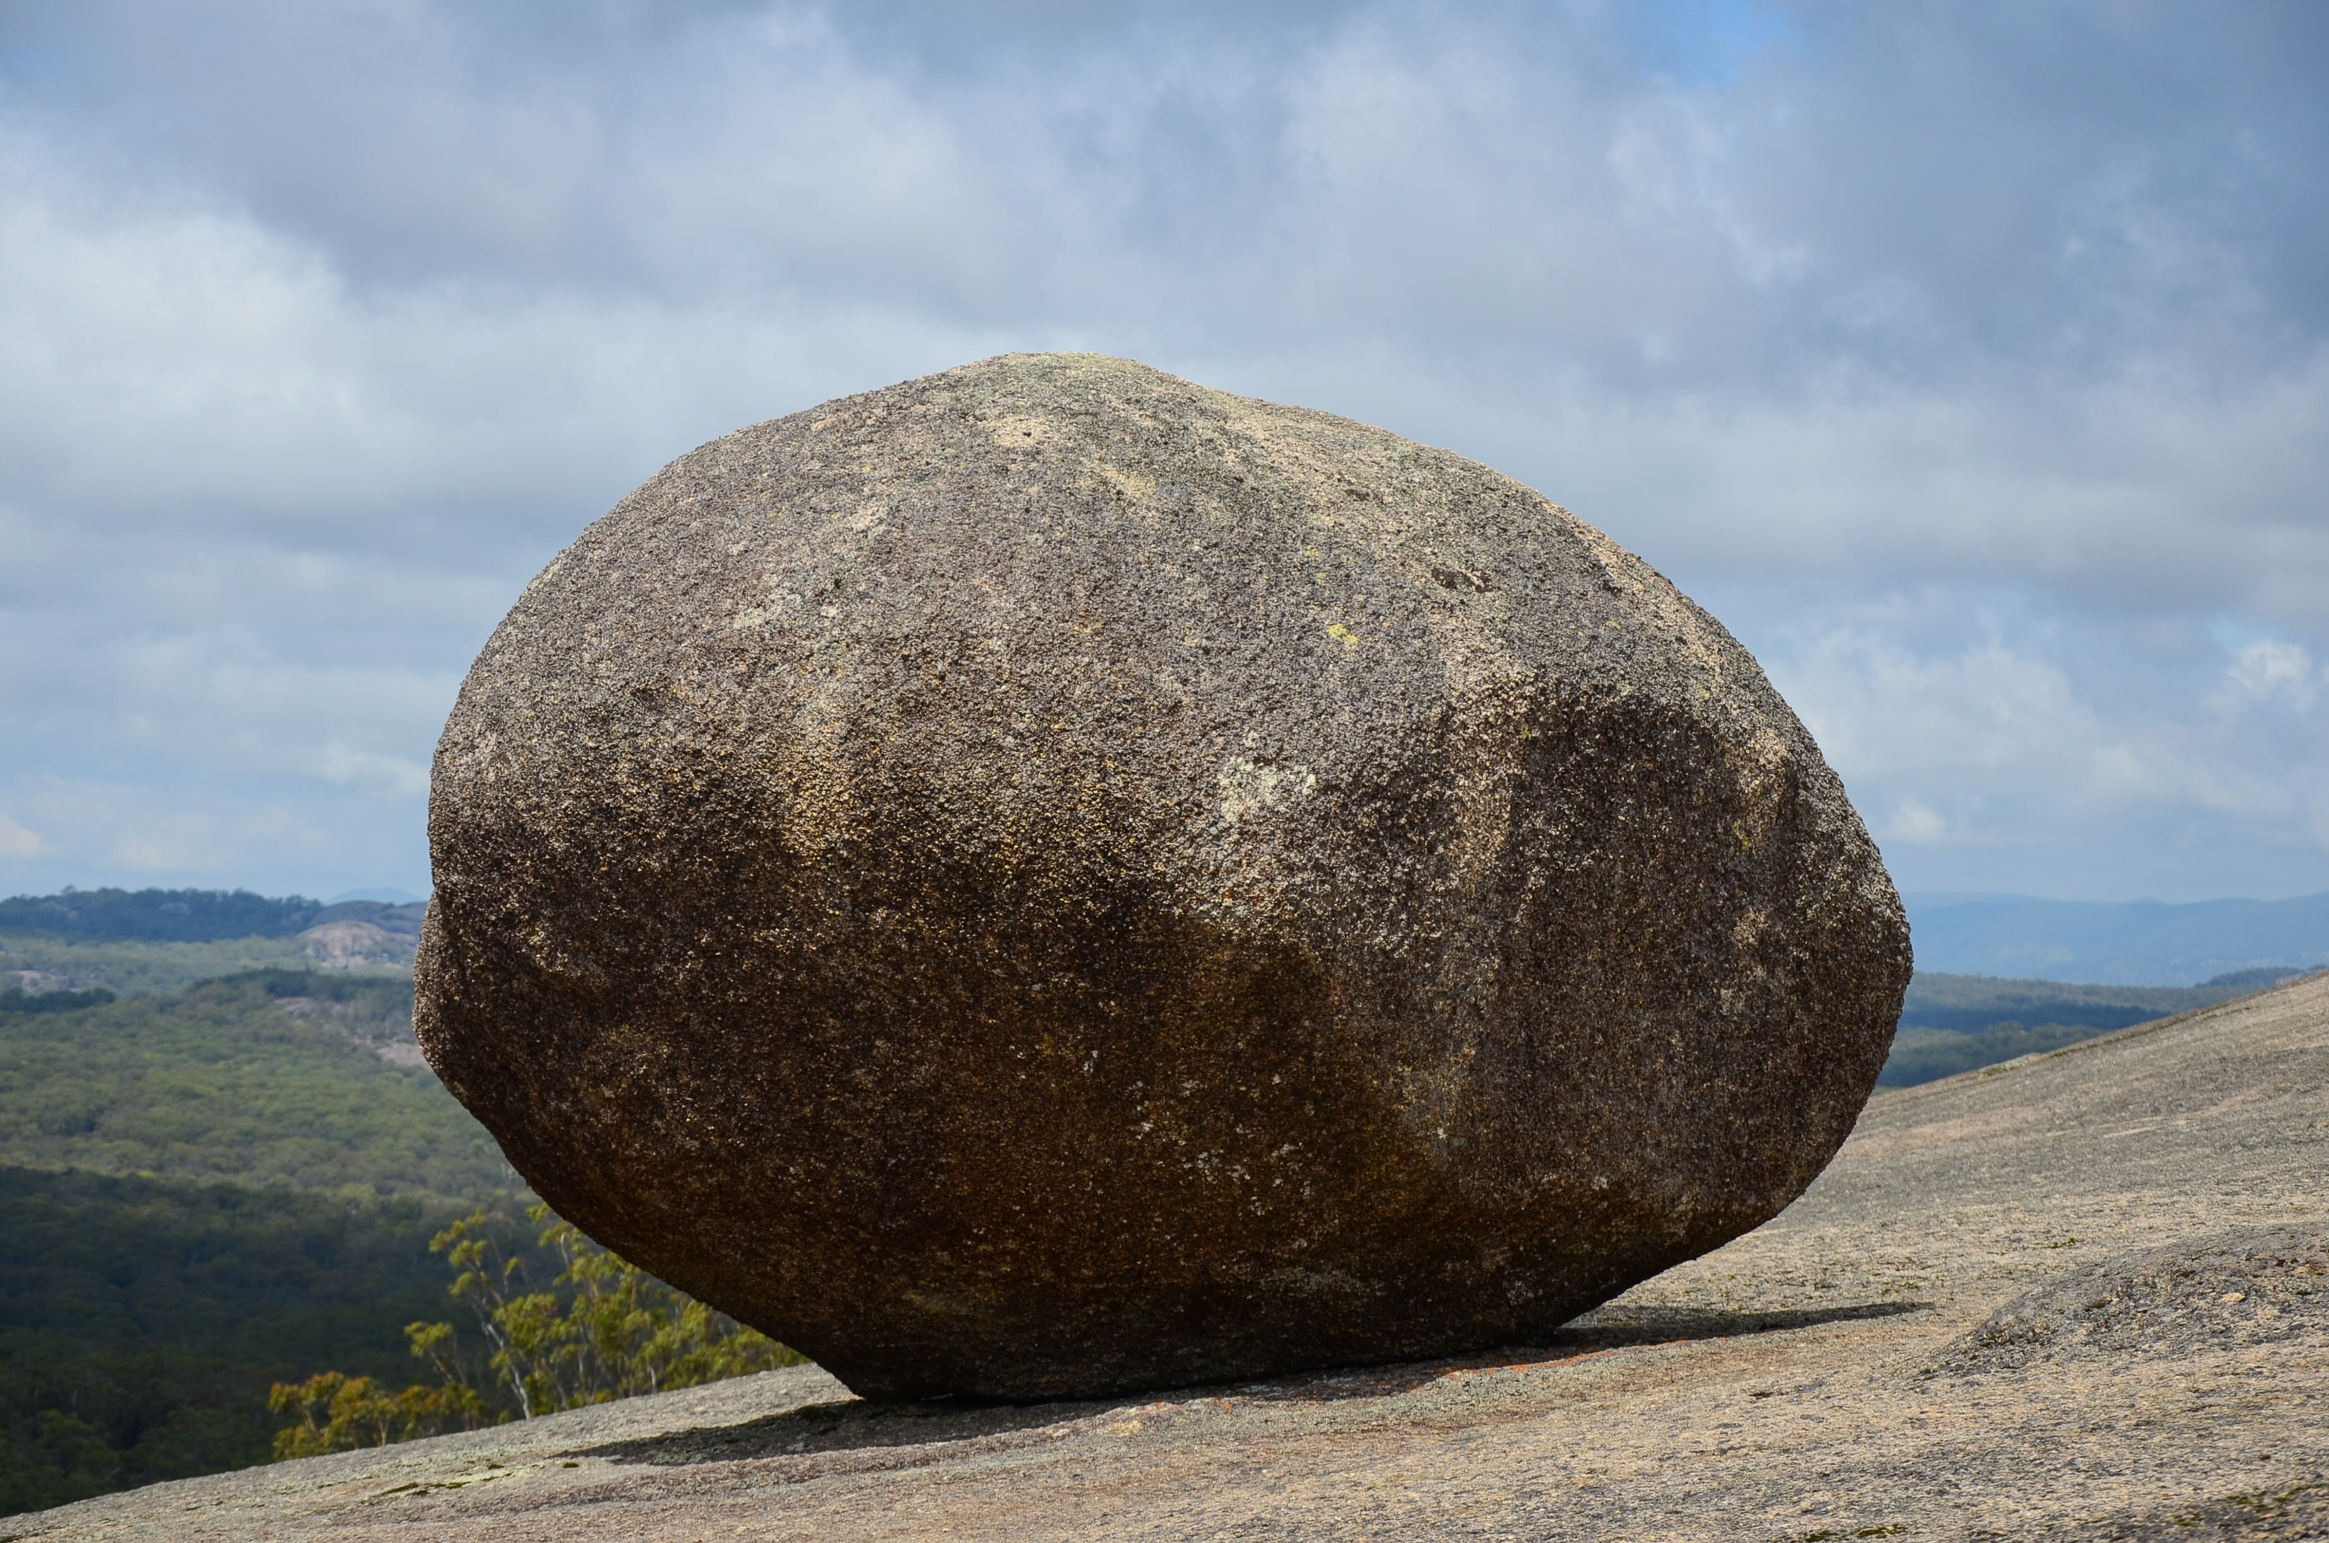
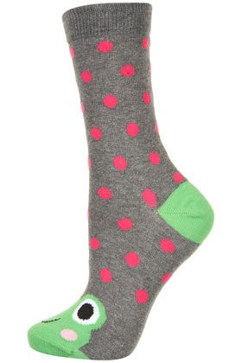
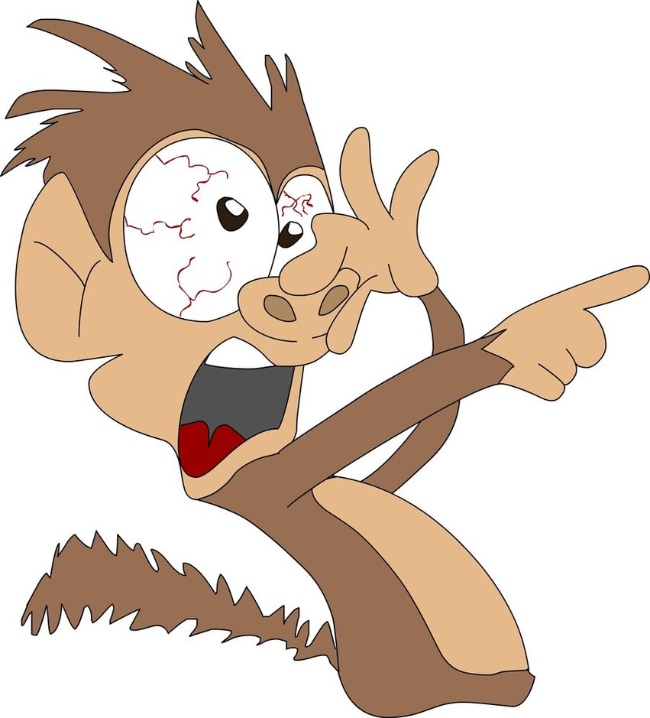
The lock and the sock are on the rock.

Slide 45
This is a hog.
The hog likes to jog.
The hog likes to jog with a log.

Slide 46
This is a lock.
This is a sock.
The lock and the sock are on the rock.

Slide 47
-ip
-it

Slide 48
ip
l

Slide 49
s
ip

Slide 50
z
ip

Slide 51
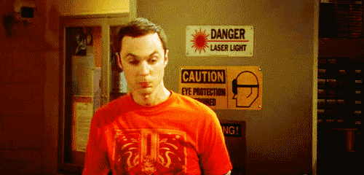
Zip your lip.

Slide 52
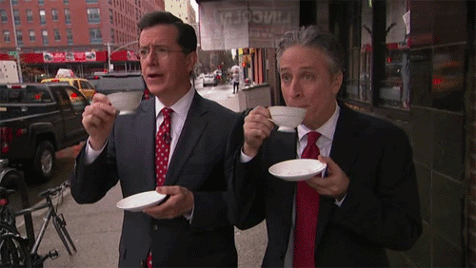
Sip your tea.

Slide 53
Zip your lip and sip your tea.

Slide 54
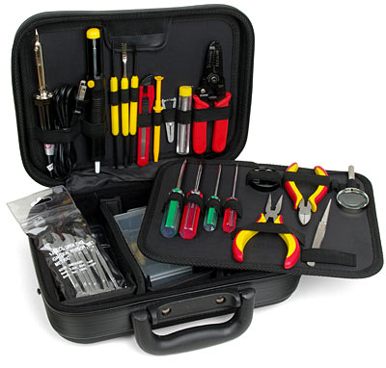
k
it

Slide 55
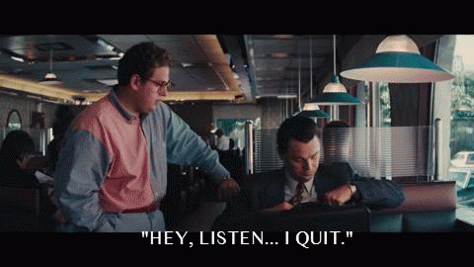
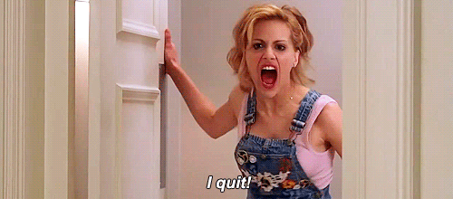
qu
it

Slide 56
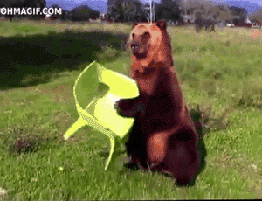
s
it

Slide 57
Don’t quit.

Slide 58
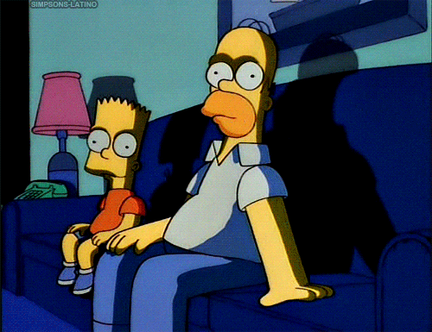
Sit for a bit.

Slide 59
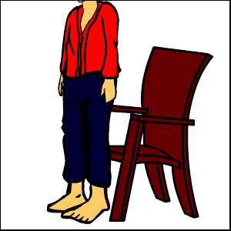
You can sit by the kit.

Slide 60
-en
-ell

Slide 61
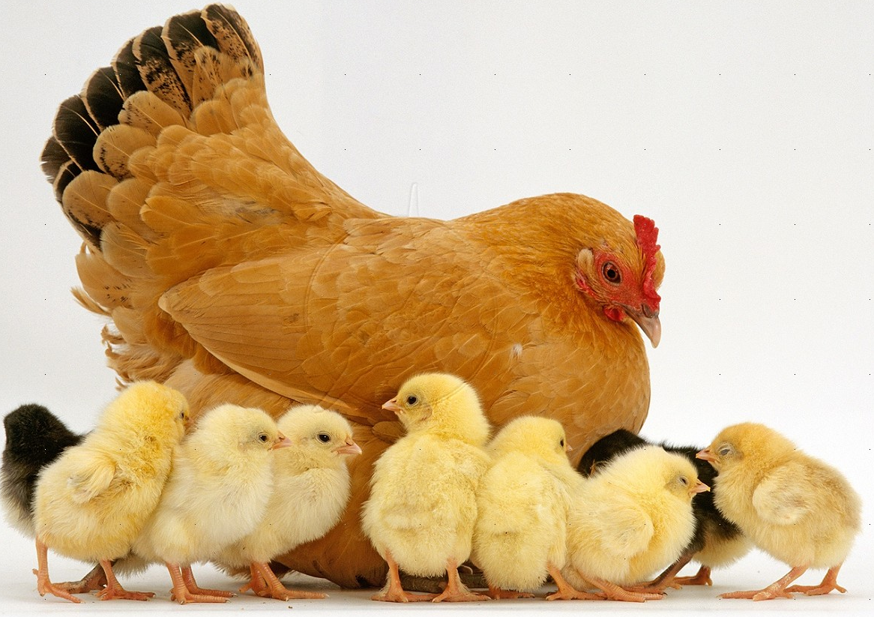
h
en

Slide 62
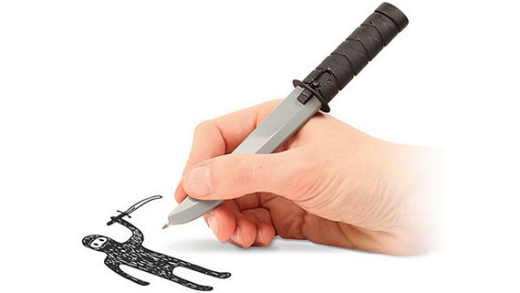
p
en

Slide 63
t
en

Slide 64
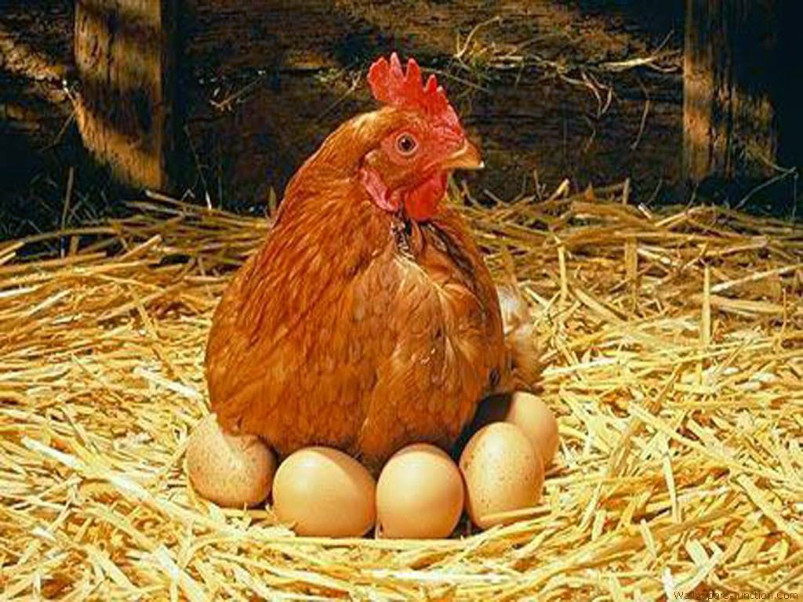
This is a hen.

Slide 65
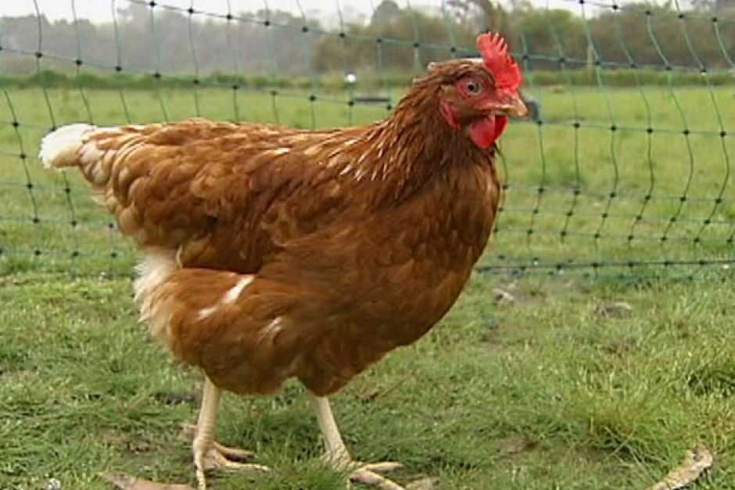
The hen has a pen.

Slide 66
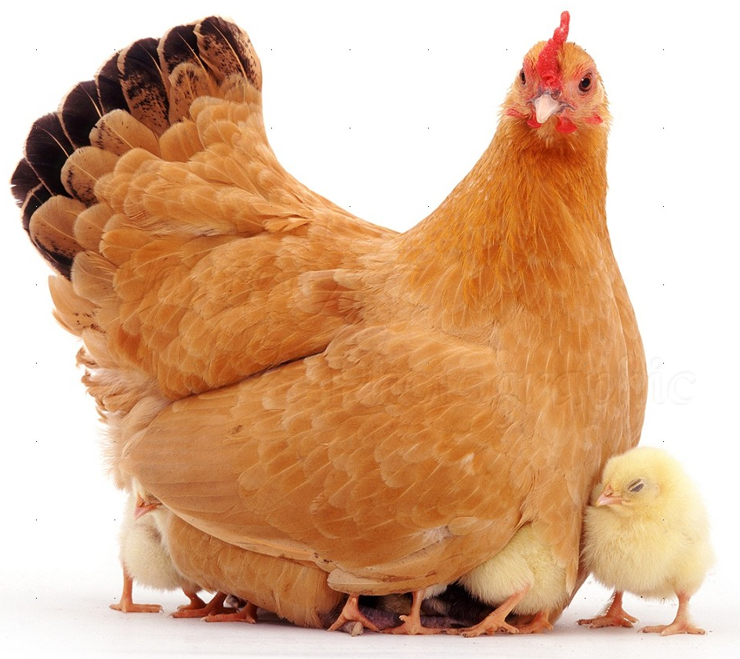
Oh! The hen has ten pens.

Slide 67
b
ell

Slide 68
s
ell

Slide 69
y
ell

Slide 70
He has a bell.

Slide 71
He can yell.

Slide 72
He can yell and sell the bell.

Slide 73
-am
-an

Slide 74
h
am

Slide 75
j
am

Slide 76
S
am
Sam Claflin

Slide 77
Sam likes ham.

Slide 78
Sam likes jam.

Slide 79
Sam likes ham
and jam.

Slide 80
m
an

Slide 81
f
an

Slide 82
v
an

Slide 83
This is a man.

Slide 84
He has a fan.

Slide 85
The man has a fan in his van.

Slide 86
英語期末考範圍:
Unit3~Unit4 (全)要背單字、Phonic+生活用語(Starter Unit ~Unit4)、口試(Unit4的Story Time，分組上台抽角色發表)

